Slide 1

Capstone Final Project
Emily Morelock
CST499: Capstone for Computer Software Technology
Amr Elchouemi
June 13, 2022

Slide 2

SRS Document Key Aspects
SRS Document Key Aspects
Introduction
Product Perspective
Testing Information
Strategies for Configuration
Defect Classification
Exit Criteria

Slide 3

SRS Document Key Aspects – Introduction.
This introduction included a summary of the product function and the purpose of the SRS documentation into multiple parts. This function covered the entire parts of the SRS documentation that were included into section 1 and 2.
The purpose of this documentation is to announce the intended requirements for the software that will give the school the ability to allow student registration. This software will be used as following student registration, username recognition, password recognition, required fields, profile information, course information, and pertinent information for the database. The requirements will be discussed below. This is the first version of this documentation, subject to change throughout the project duration as the specifications change. This SRS will include the entirety of the project.

Slide 4

SRS Documentation Key Aspects – Product Perspective
The product perspective is responsible for explaining the details of the product in depth and controlling changes within the documentation.
The project that is being tested is implementation for the web development that will allow students to log in, register, sign up for classes, and delete them from their schedule. This project will be responsible for implementing the tracking of usernames, passwords, classes, profile information, and waiting lists for classes. The user should have the function which will include a website with a landing page including a welcome notice with a navigation bar included that will give the user the ability to move from the landing page to the log in page, registration page, and available classes. This is being deployed through Bootstrap using programming languages that include PHP, CSS, HTML, and JavaScript to deploy those functions. From the log in page, there is an included section with a username and password text input and a submit button function that will send the user information to MySQL database to validate and authorize the user access. The registration page will record user information that includes the users first name, last name, email address, birthdate, physical address, previous student history, and classes that they would like to attend. There will be another page which will validate user information and bring a profile card with user information including current registered classes.

Slide 5

SRS Document Key Aspects – Testing Information
This section covered all of section 3 within the SRS Documentation and is responsible for explaining the testing teams, types of testing, testing tools, and testing estimations.
The first executed test in this SDLC will be the Unit Testing. This testing will implement the project manager for division in testing this portion to ensure that all required information from the website can be recorded, authorized, and return properly. Team 1 will take this testing portion. System and Integration Testing will test the entire website, to ensure that all components are communicating. This testing will be divided to Team 2. Performance and stress testing will be divided to Team 3 and will test how the website reacts while multiple users are on the website by registering, logging, in and managing classes. This team will also be responsible for returning the websites response time. User acceptance testing will be divided to Team 4 and the project stakeholders to ensure that the website is ready for release. Regression testing will be divided to all teams depending on what will need to be retested.
Unit Testing | >1 min | <10 min
System and Integration Testing | >10 min | <2 days
Performance and Stress Testing | >5 min | <1 day
User Acceptance Testing | >2 days | <10 days
Regression Testing | >1 min | <30 min

Slide 6

SRS Document Key Aspects – Strategies for Configuration
Strategies for configuration only needs one section for this project purpose and is responsible for changes made within the team, project, and documentation.
The software configuration management will be responsible for organizing, managing, and changing documents, coding, and the project management cycle that are included through this process. Strategies that will be included to aid in this portion of the project, which will be controlled by the project manager, documenting changes, identifying, and tracking required configuration, and testing that the team understands and will adhere to the changes within the configuration changes.

Slide 7

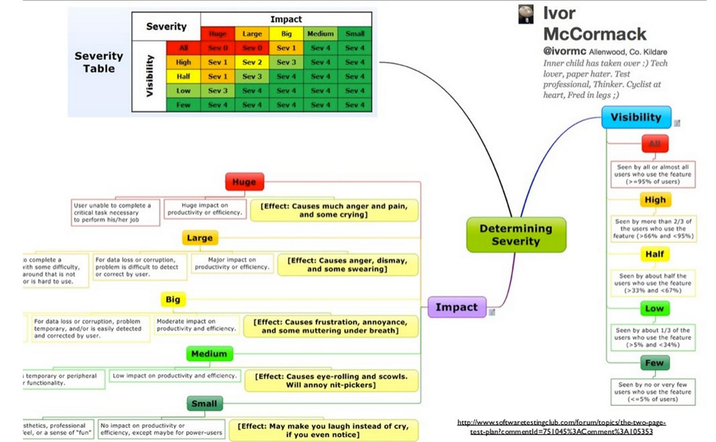
SRS Document Key Aspects – Defect Classification
This specific part will let the team know how defects are to be classified and categorized.

Slide 8

SRS Document Key Aspects – Exit Criteria
The exit criteria clears up any unfinished business and brings the estimations for how long testing will take within the project development.
Type of Testing | Due By | Total Cost Estimation
Unit Testing | July 15^{th,} 2022 | $400-700
System and Integration Testing | July 30th, 2022 | $505-630
Performance and Stress Testing | August 1st, 2022 | $200-300
User Acceptance Testing | August 12th, 2022 | $100
Regression Testing | August 29th, 2022 | $500

Slide 9

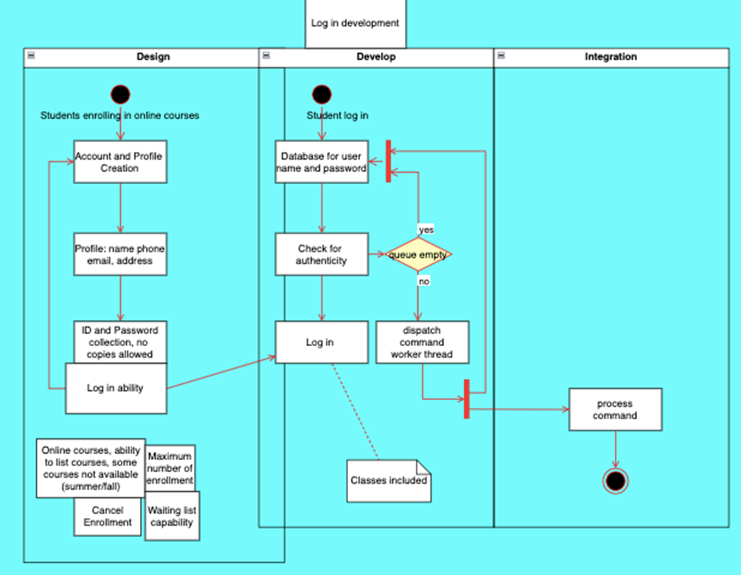
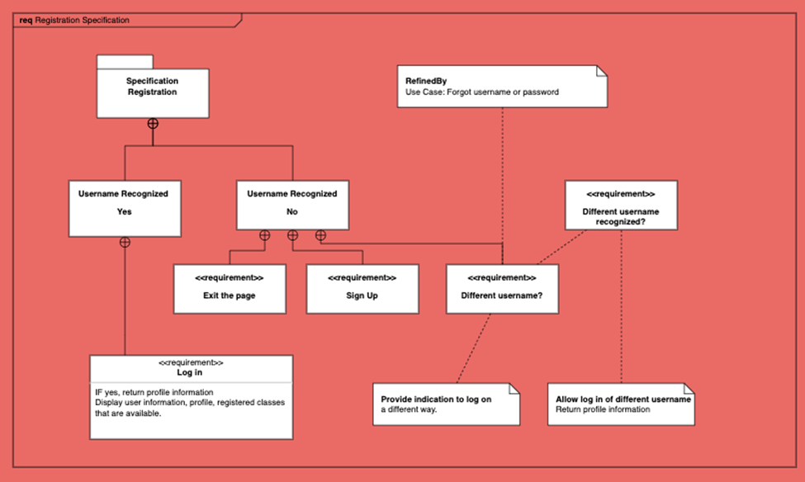
UML Design Model
The Registration design model below showcases how the user will enter information and be validated through the database back to the website.
This UML Design model show cases the validation and authorization process to and from the database when a user logs in.

Slide 10

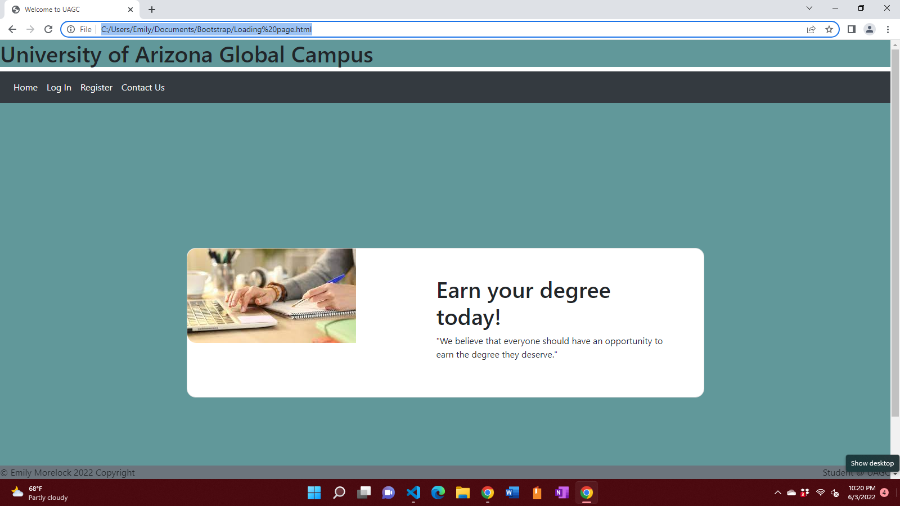
Landing Page
This is the page that the users will see when they first go to the URL that hosts the university website.

Slide 11

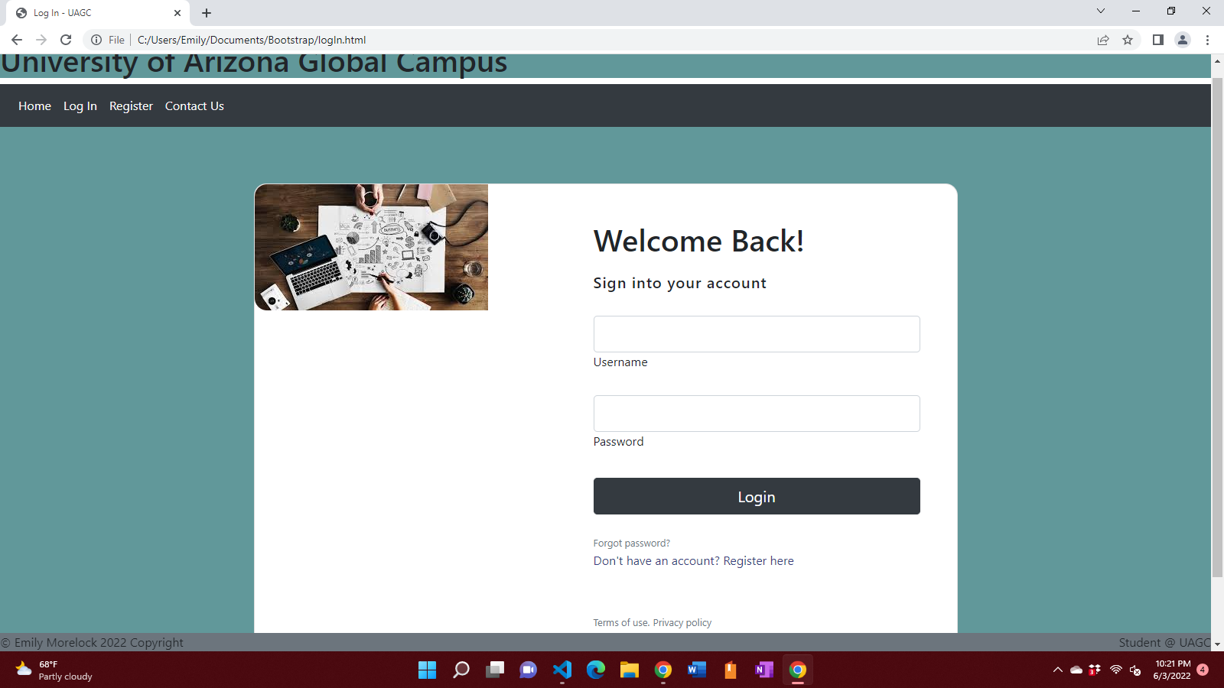
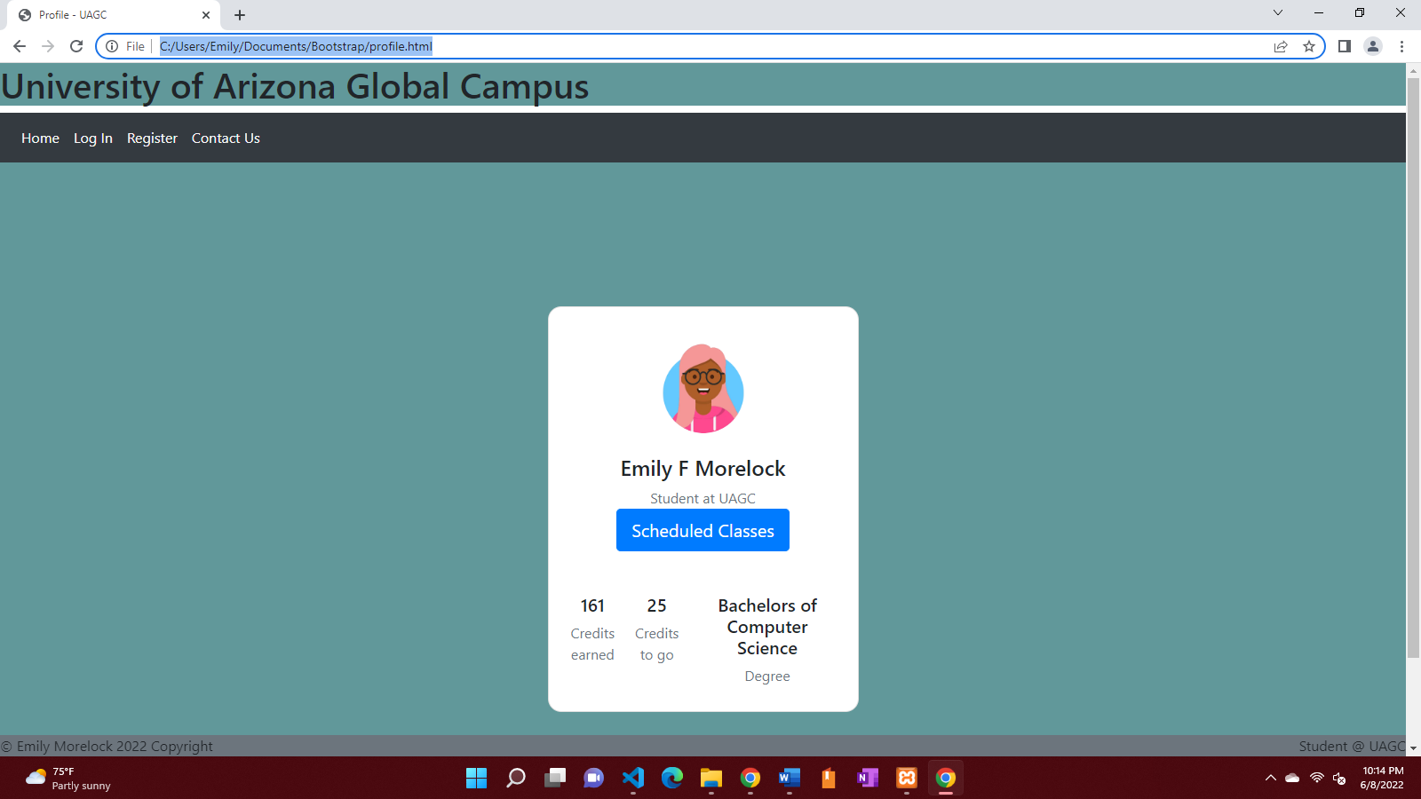
Log In Page
This page will be for registered users and will go to a profile with user interaction.

Slide 12

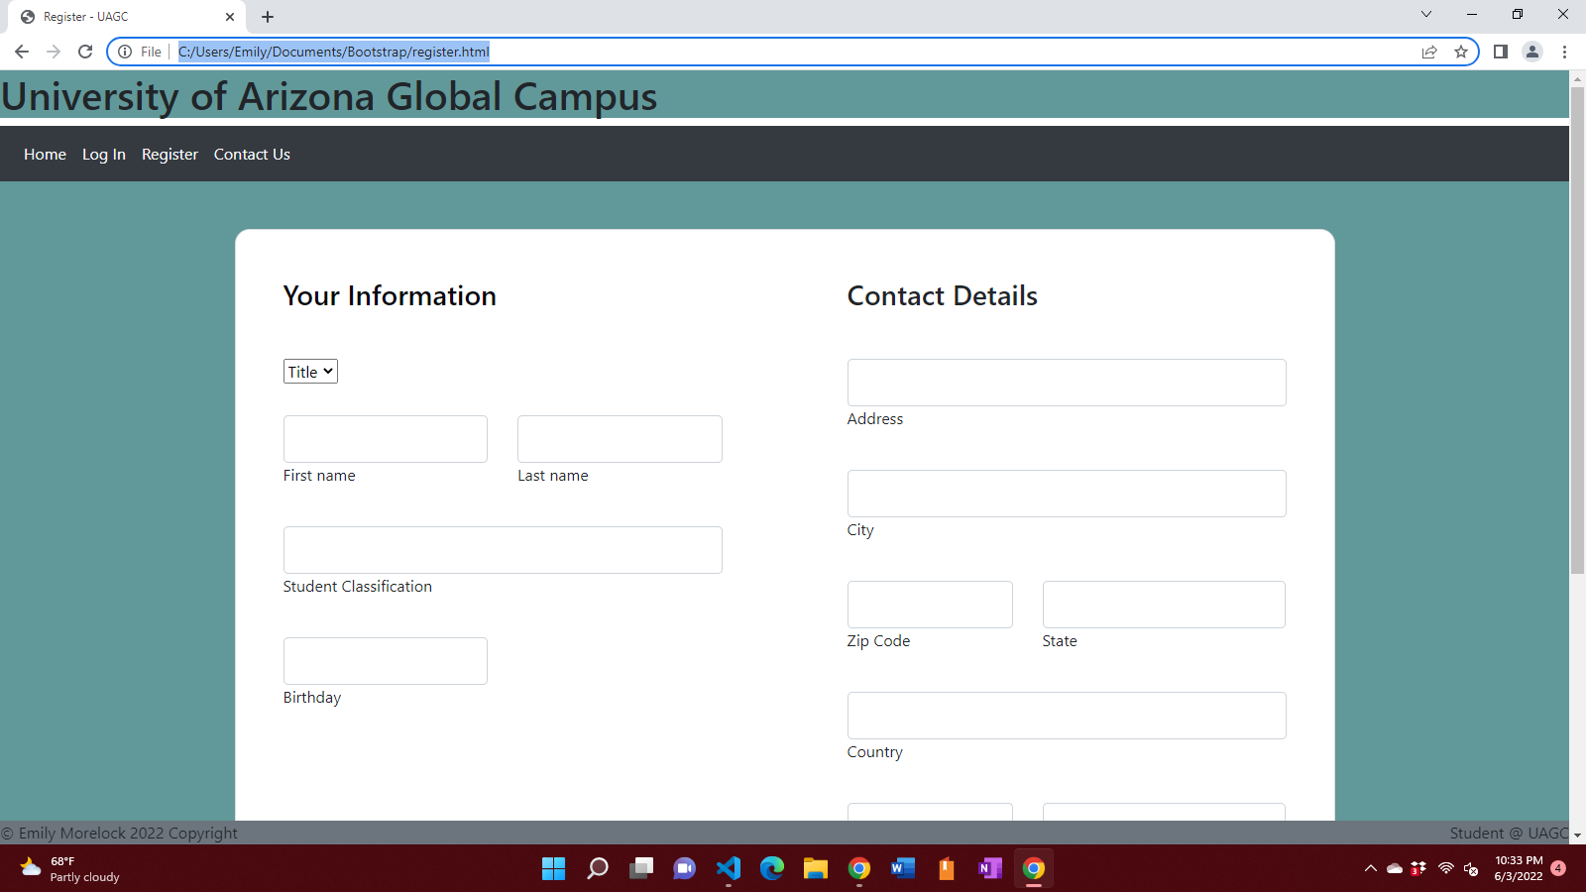
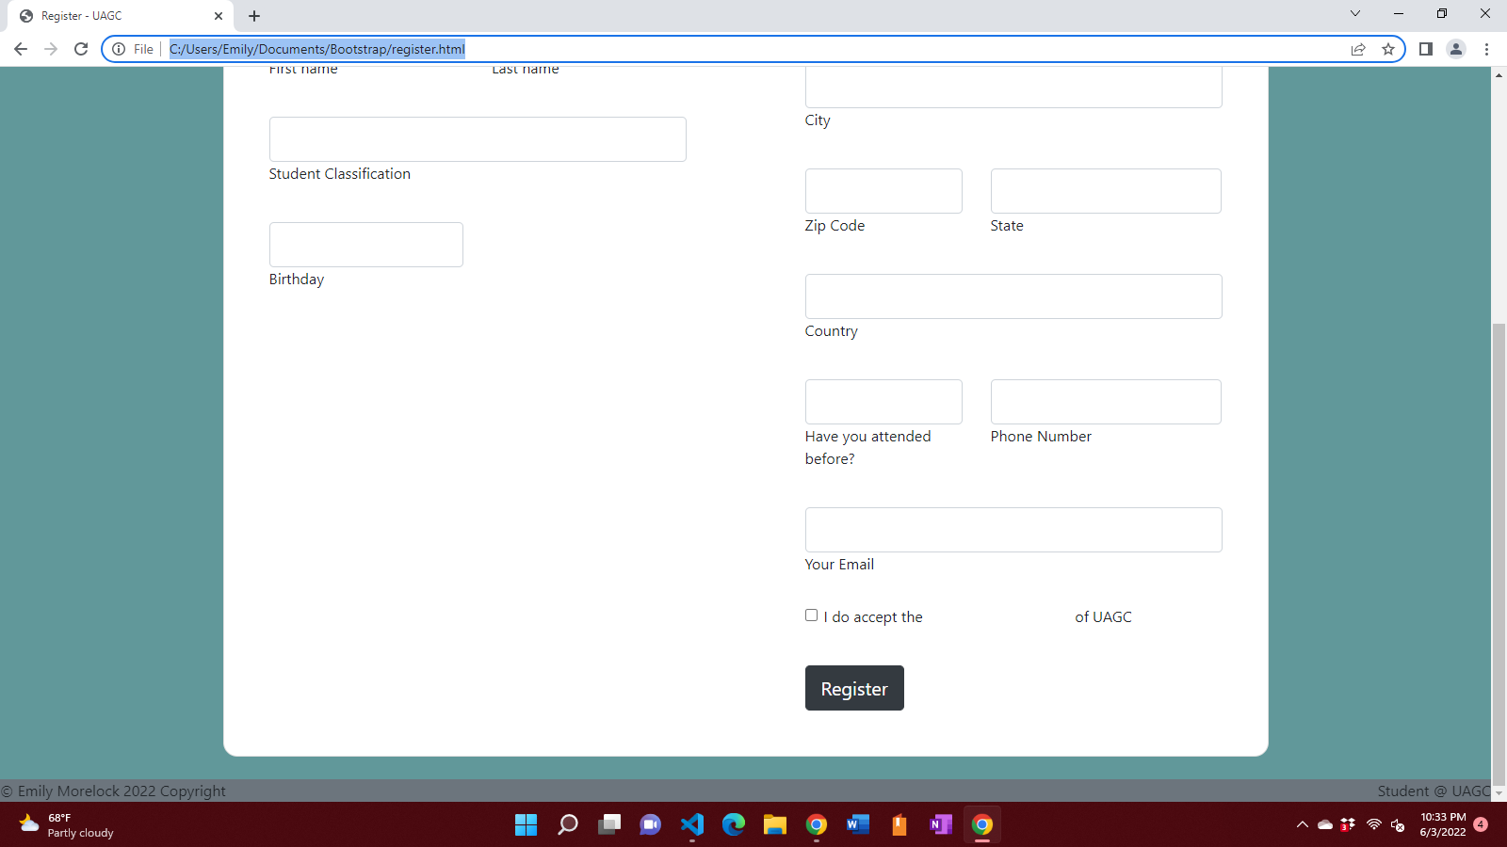
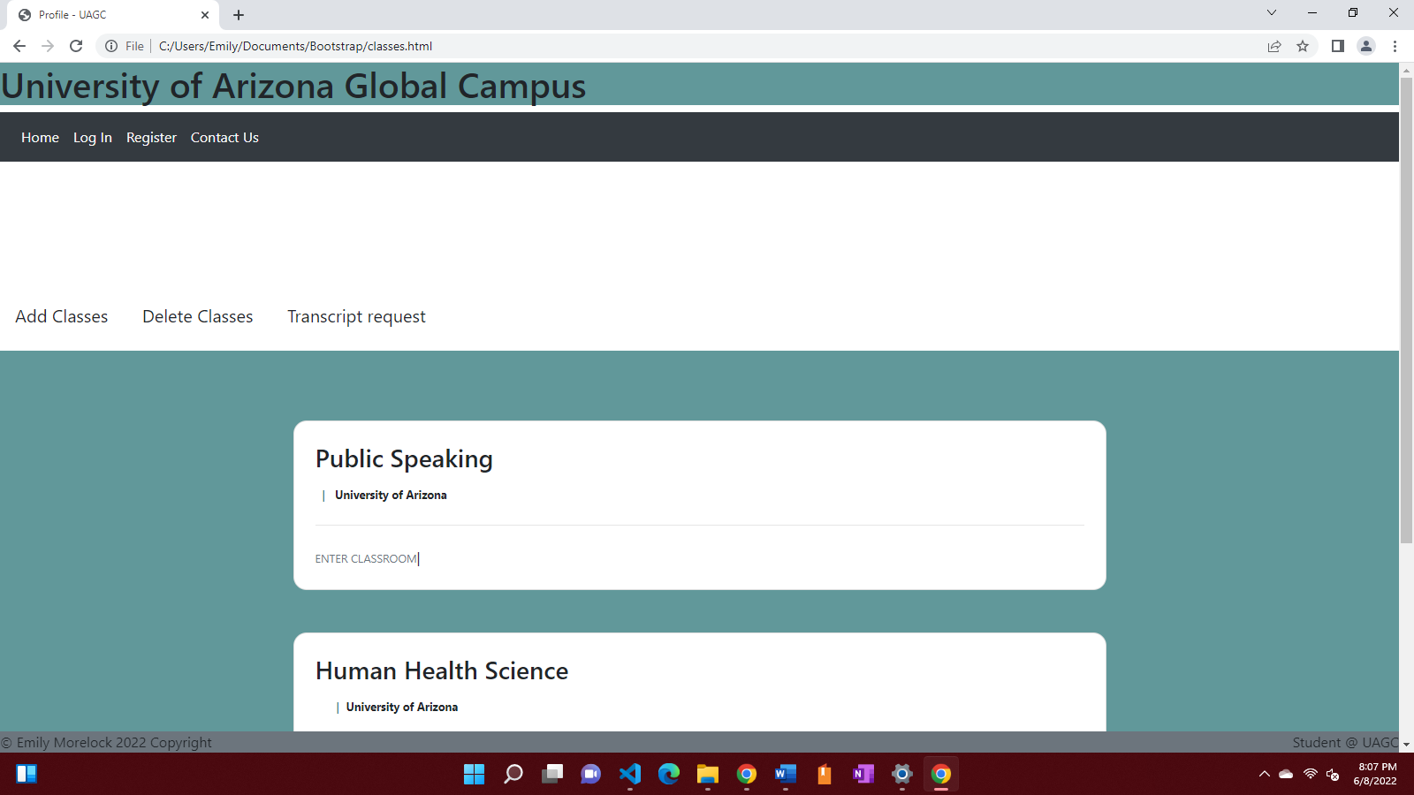
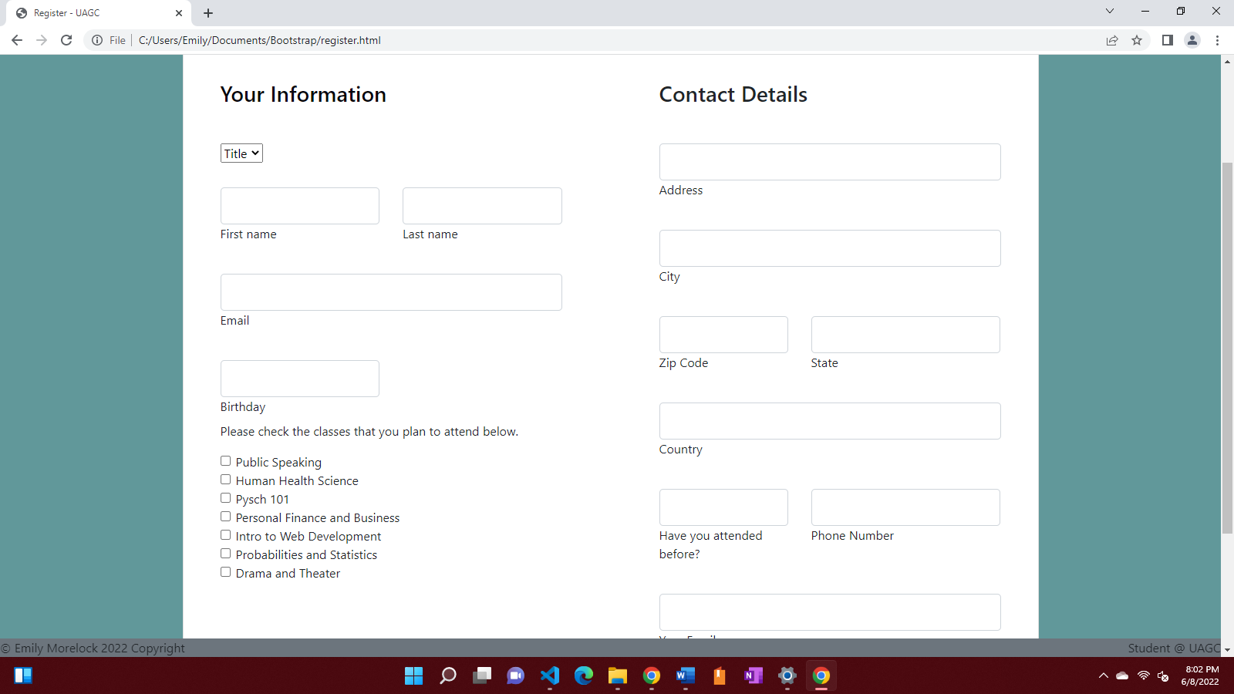
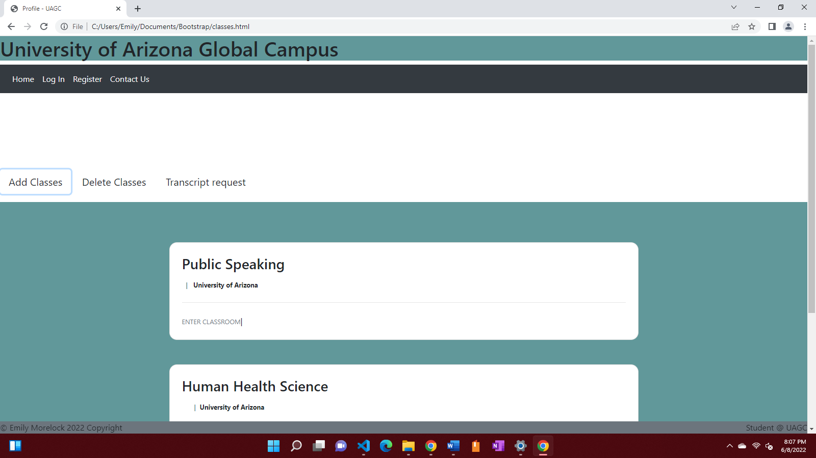
Class and Enrollment Pages

Slide 13

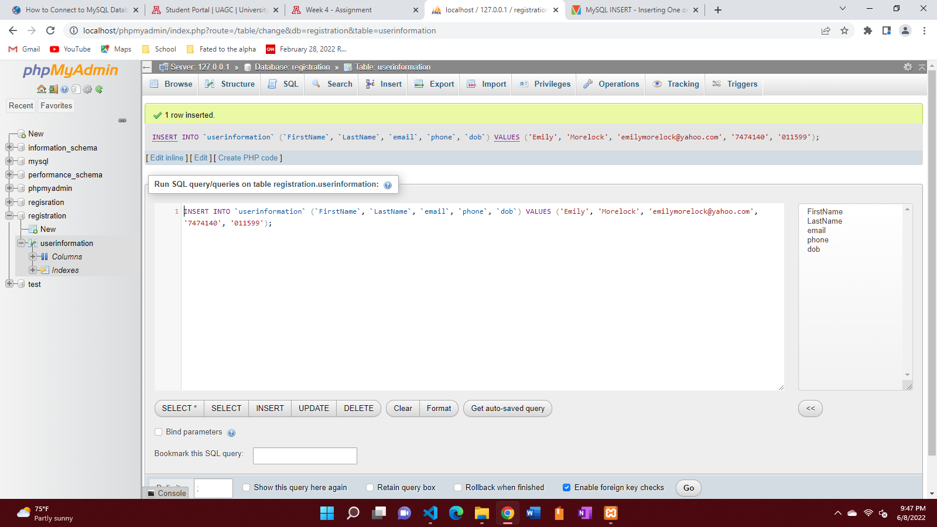
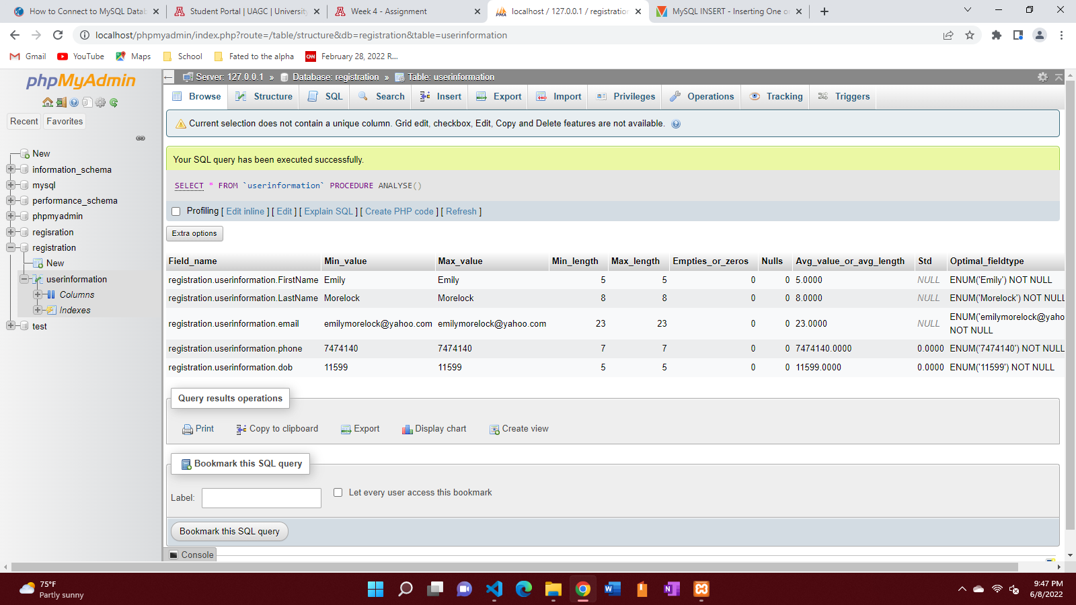
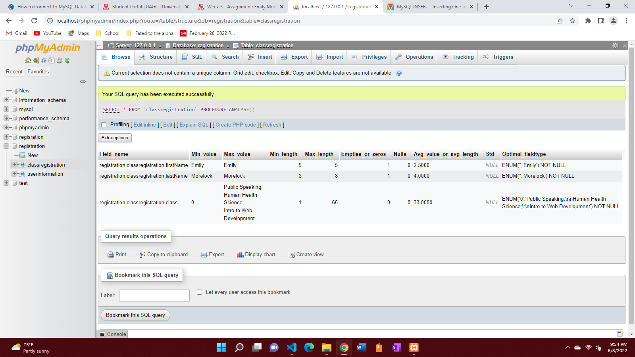
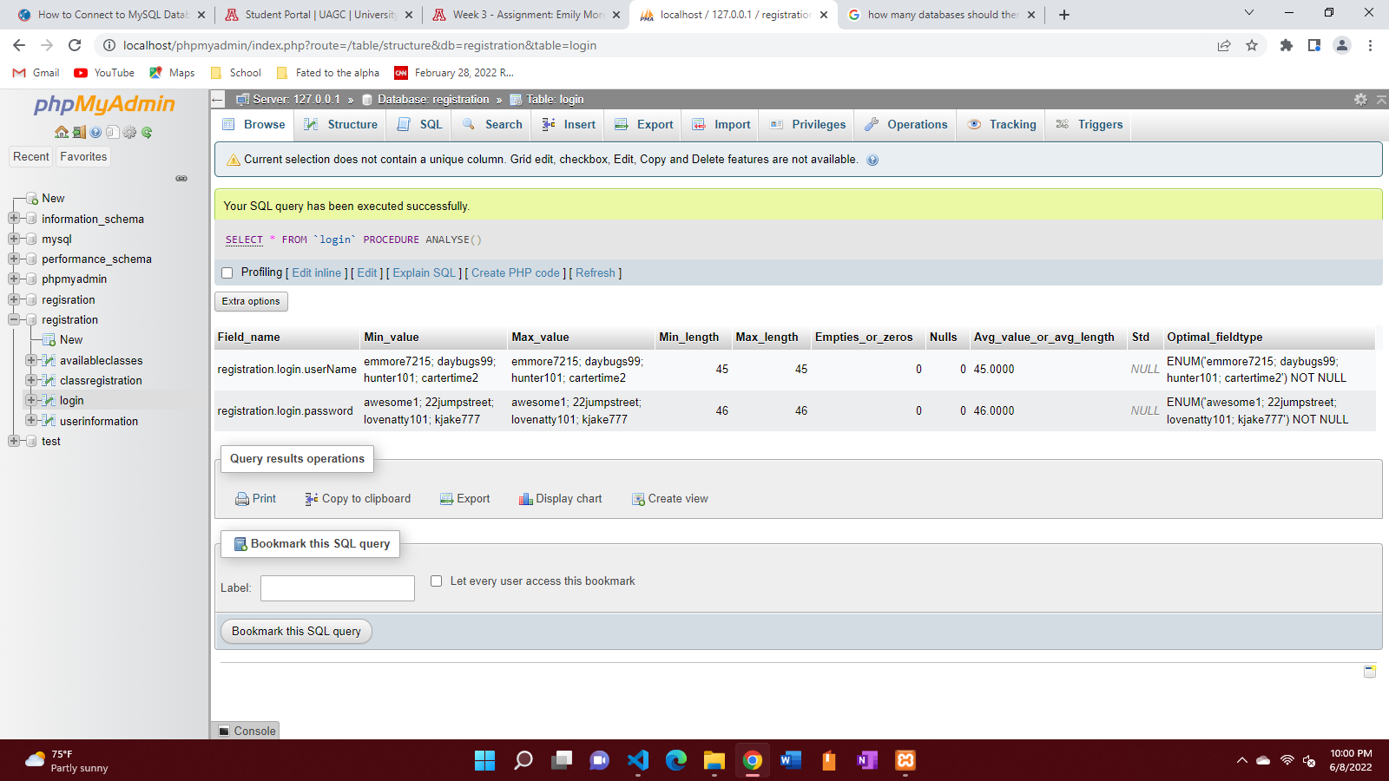
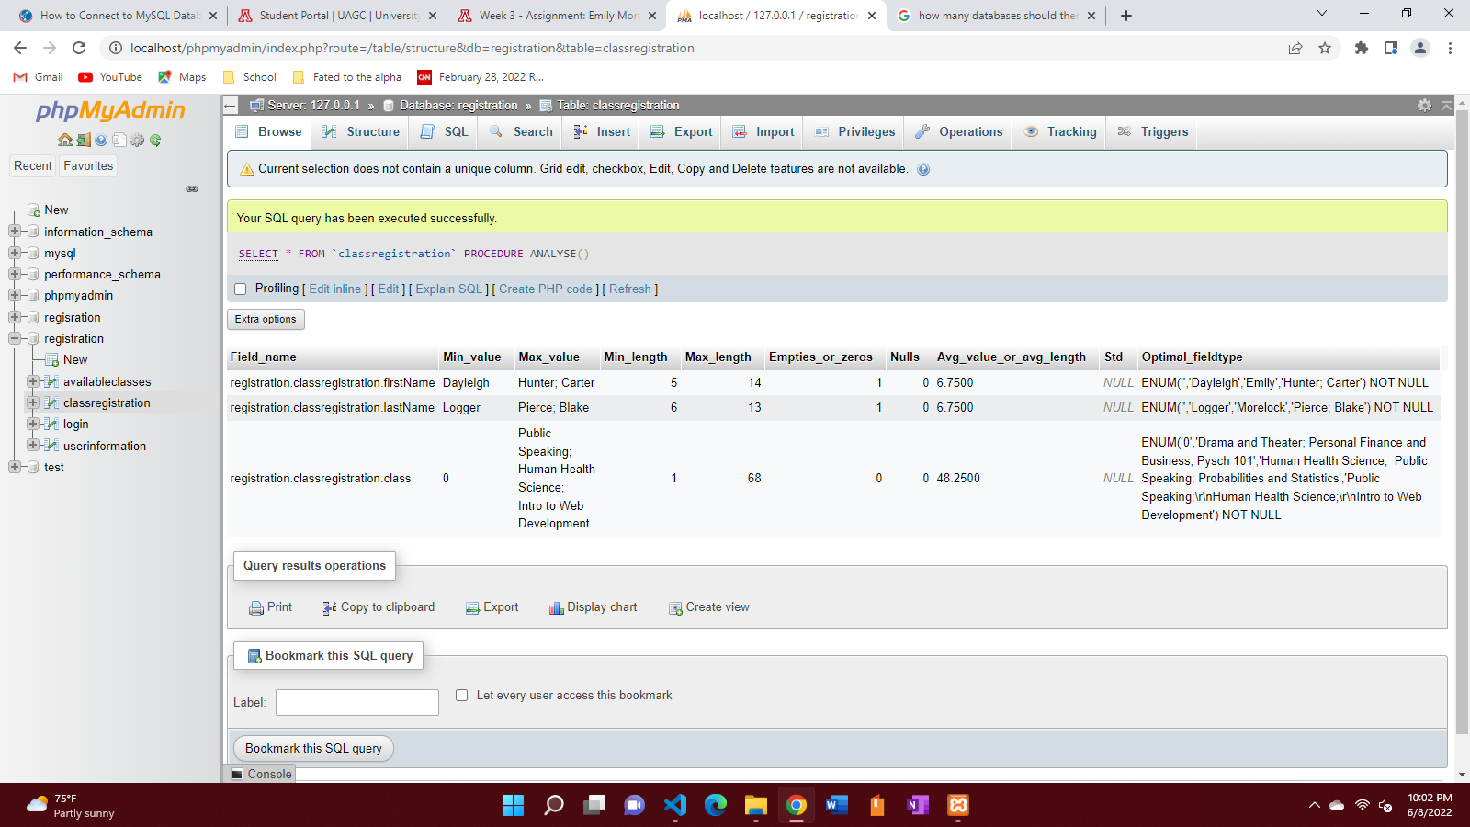
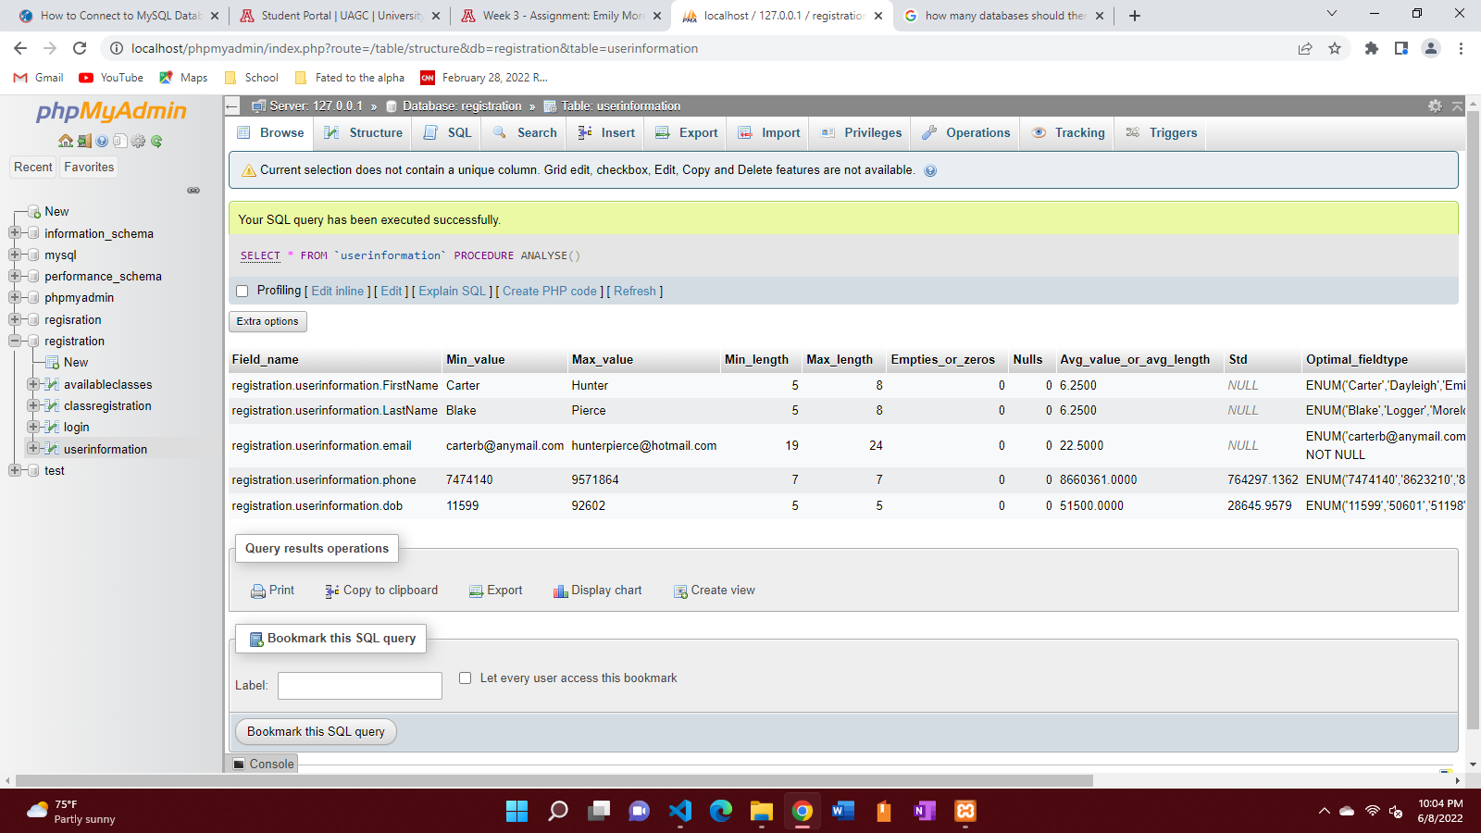
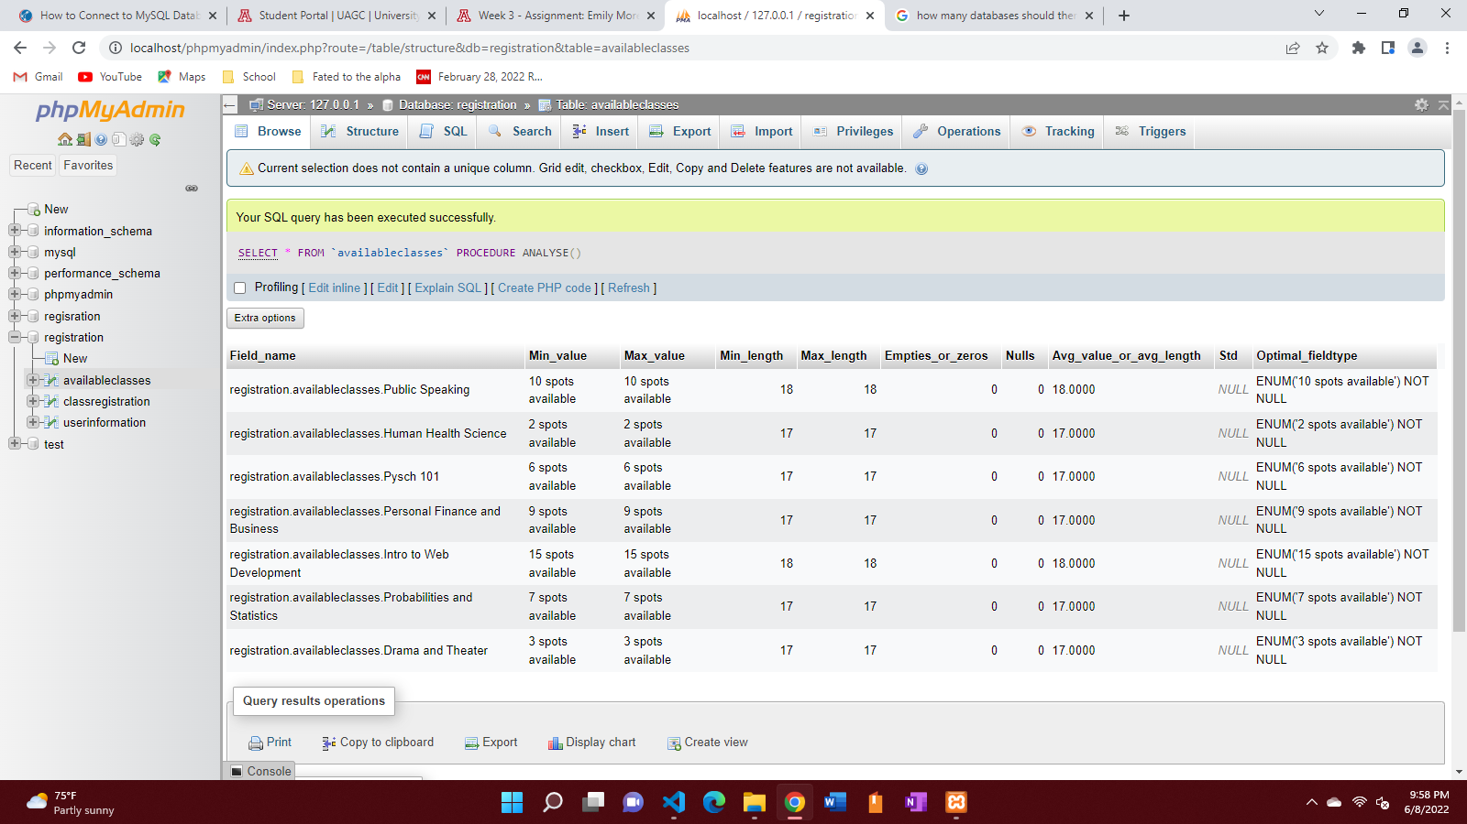
MySQL Database

Slide 14

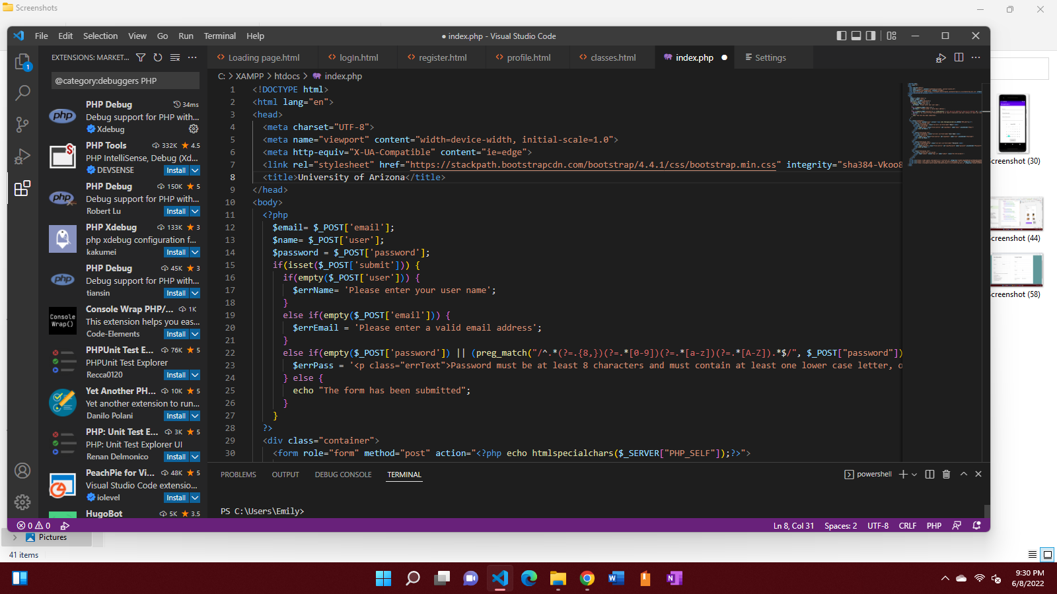
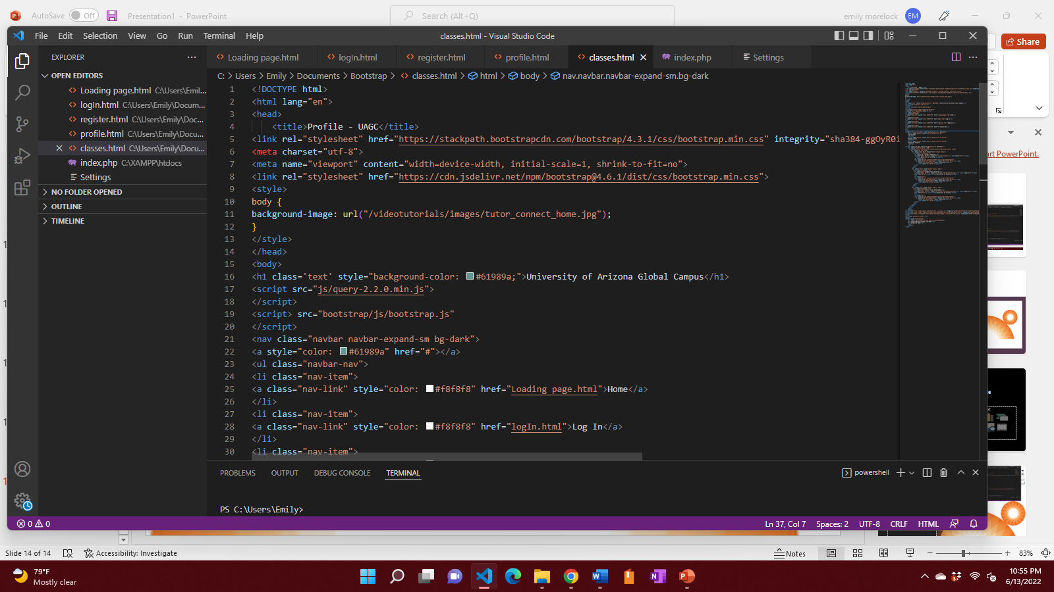
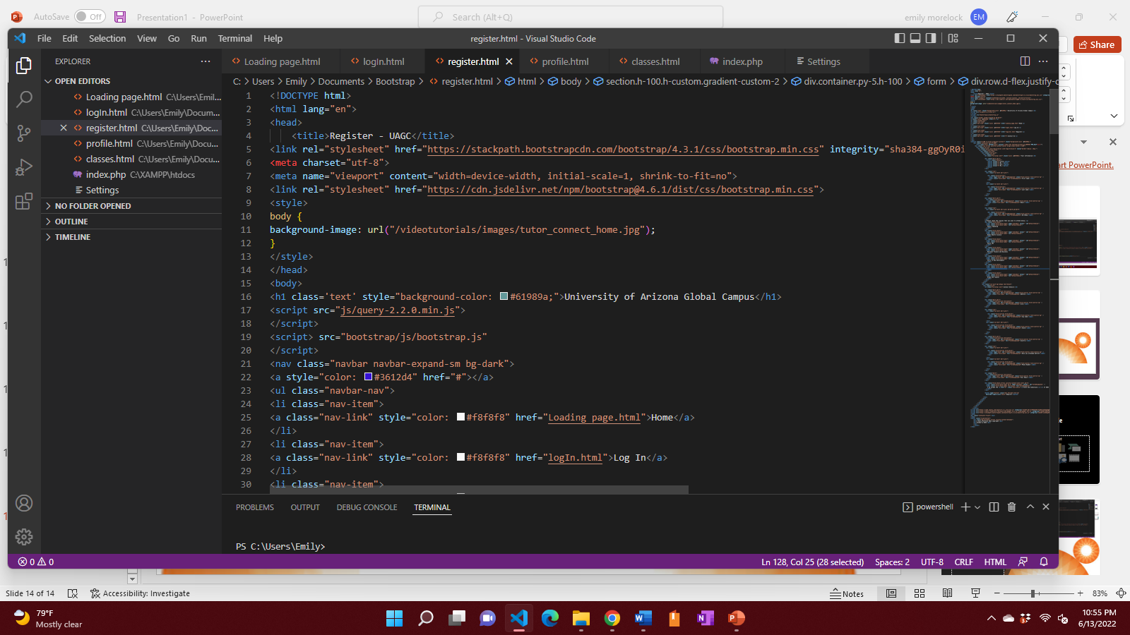


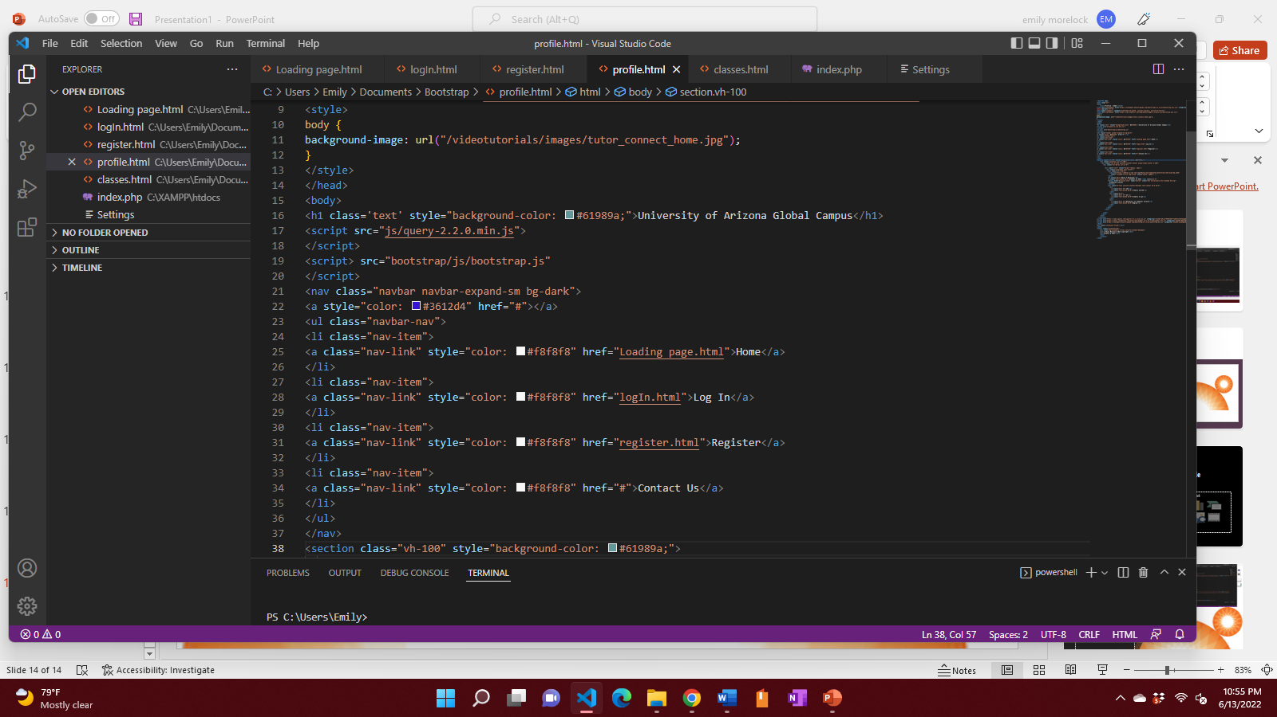
PHP Code

